Slide 1

Dr. A P J Abdul Kalam School of Engineering
Spotify Clone website
Group Members:
1) Kushi .M (Reg no.:23BTIT126) git hub ID: kushim2005
2) Priyanka .B (Reg no.:23BTIT143) git hub ID: motuuuu
3) Rakshitha .P (Reg no.:23BTIT145) git hub ID: rakshiiiiiii
4) Tejashwini .M (Reg no.:23BTIT162) git hub ID: tejashwinim12

Slide 2








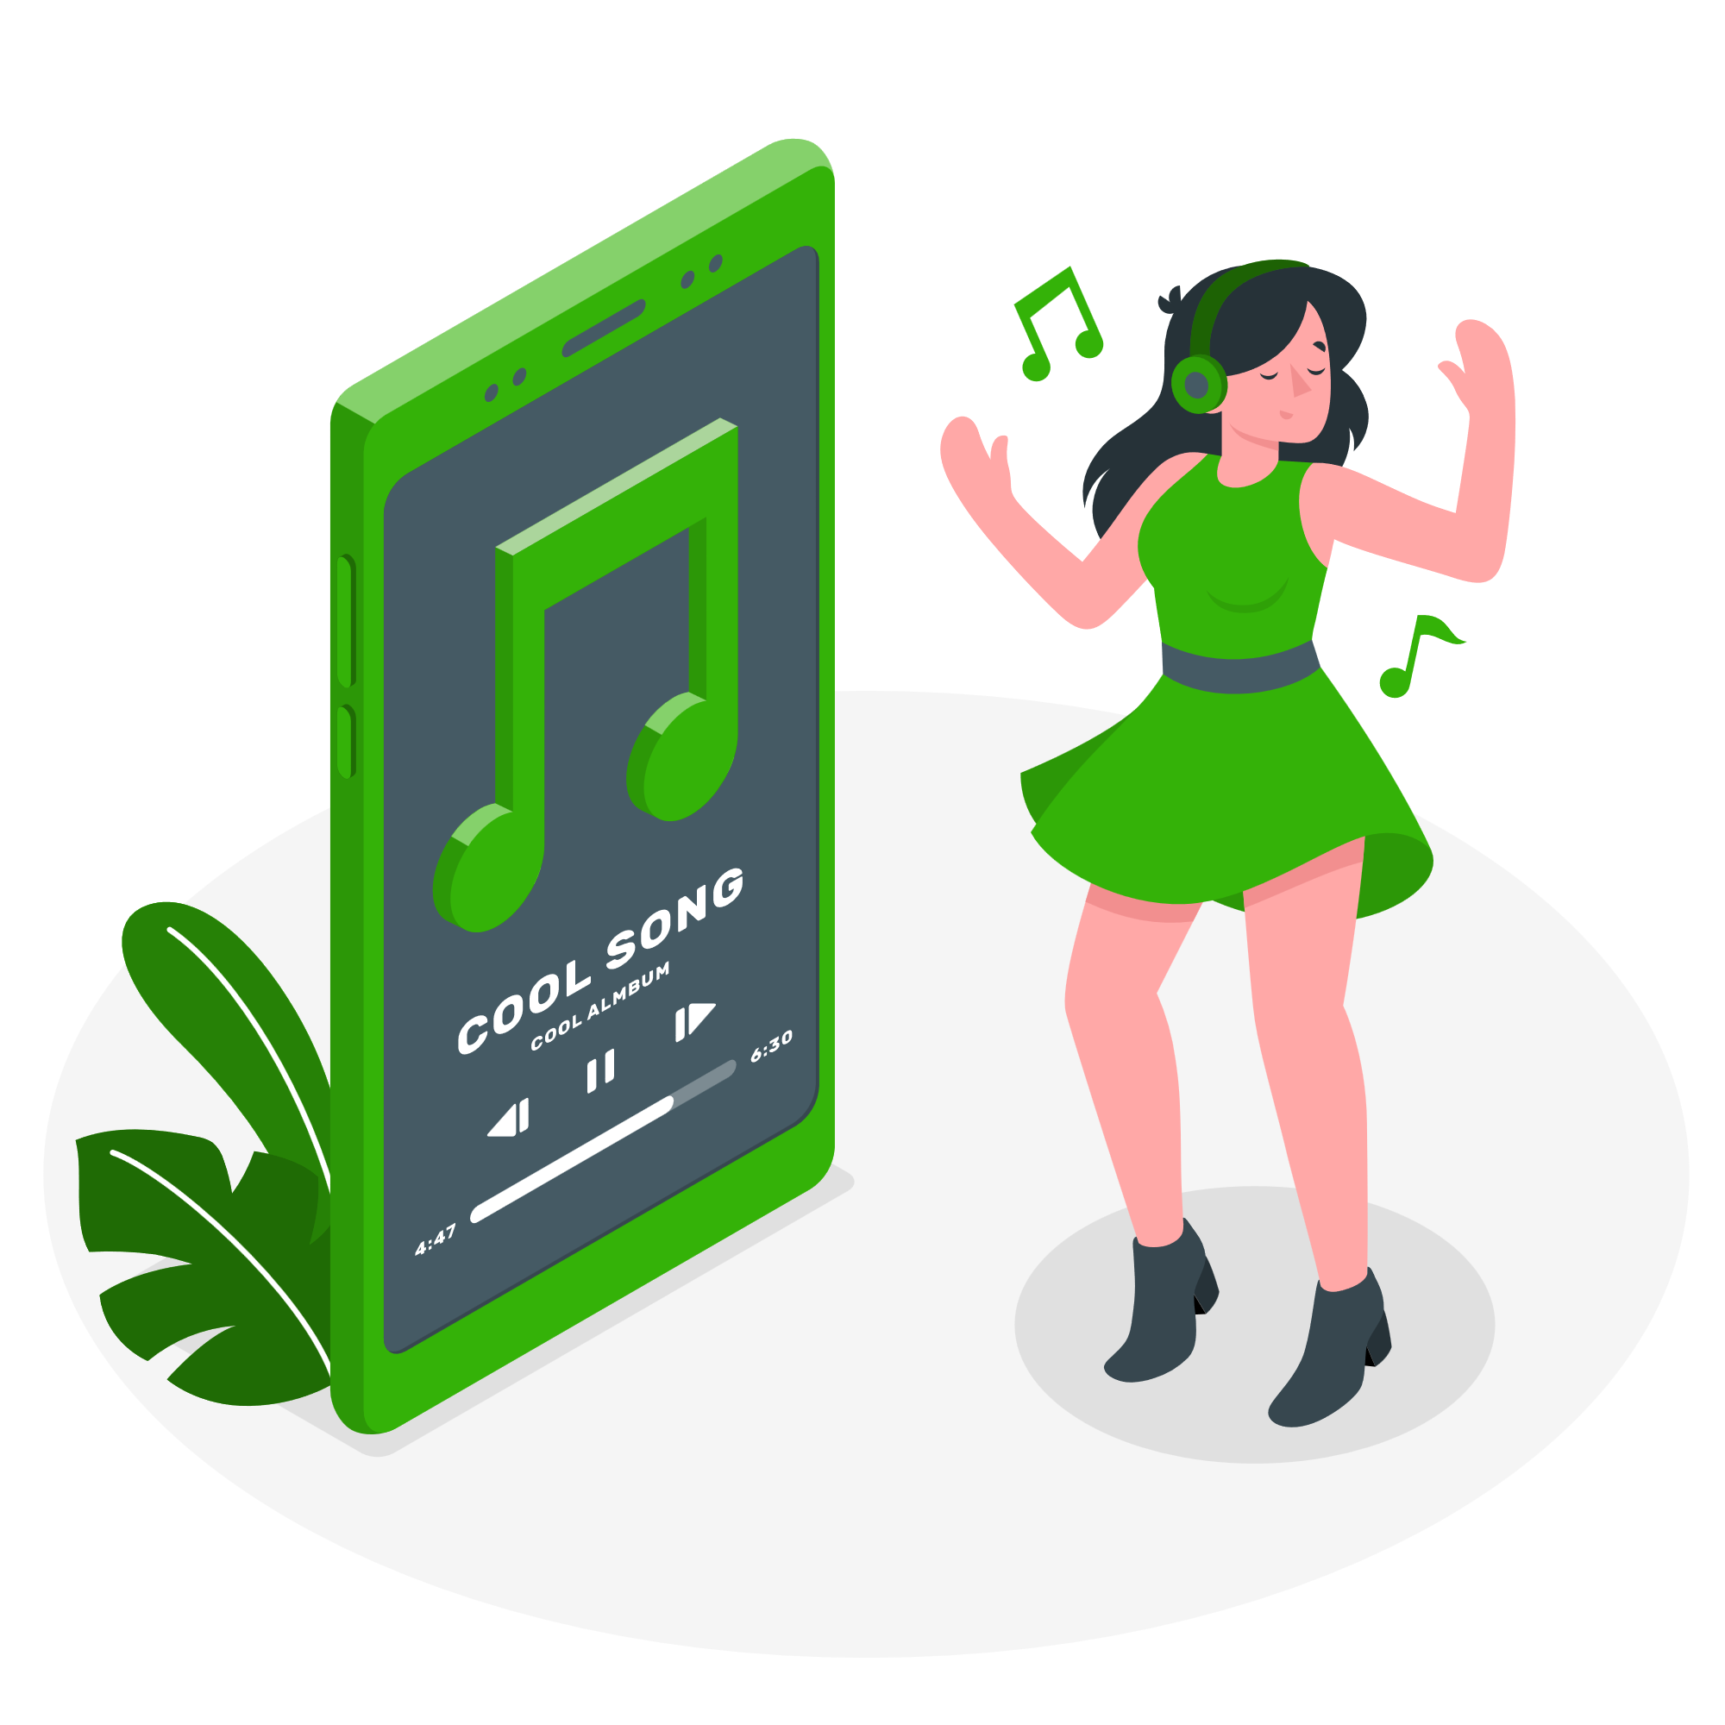
SPOTIFY
CLONE Website

Slide 3
INTRODUCTION
The Spotify clone is a web-based music player created using HTML, CSS, and JavaScript.
The HTML structure defines the layout.
CSS stylizes the elements to mirror Spotify's aesthetic.
JavaScript handles dynamic functionalities, allowing users to play, pause, skip tracks, and adjust volume seamlessly.
Overall, this project aims to provide a user-friendly and visually appealing platform for music streaming enthusiasts, emulating the core features of the popular Spotify application.

Slide 4
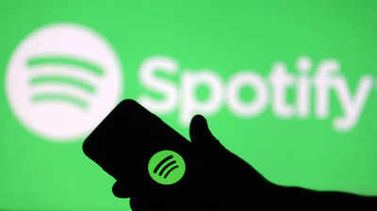
Problems scoping
Too many ads and annoying limitations in the free plan.
Limits to downloading songs
More Data usage
We will not be able to manually play songs in a specific order, or even rewind.
We will not be able to repeat songs, go back to previous songs, or select a specific part of a song.
Smart Shuffle will be the default listening mode for all free users, and they will not be able to disable it.

Slide 5

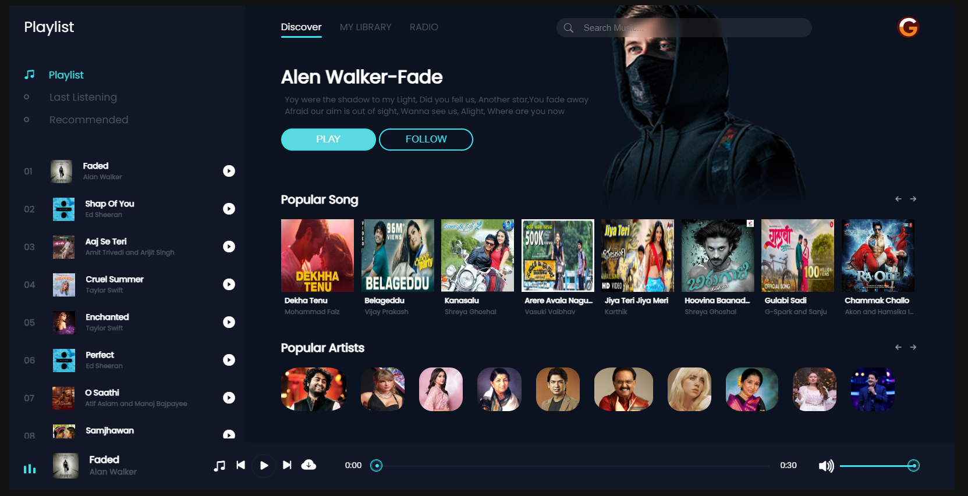
Features
No ads and limitation
No limits to downloading songs
Less Data usage
We can manually play songs in a specific order, or even rewind.
We can repeat songs, go back to previous songs, or select a specific part of a song.
Increase or decrease the volume.
It even has a search bar to look for songs, artists, and albums.

Slide 6
Interface Design

Slide 7
Future Scopes
Enhanced Recommendation Algorithms:
Invest in machine learning and AI algorithms to improve personalized music recommendations based on user preferences, behavior, and context.
Podcasting Integration:
Integrate podcast streaming capabilities to cater to the growing demand for podcasts and audio content, providing users with a broader range of audio entertainment.
Social Features:
Expand social features, allowing users to connect with friends, share playlists collaboratively, and discover music based on the preferences of their social network.

Slide 8
Virtual Reality (VR) and Augmented Reality (AR) Integration:
Explore immersive technologies like VR and AR to create unique and interactive music experiences, such as virtual concert simulations or AR-enhanced album covers.
Offline and Limited Connectivity Improvements:
Enhance offline mode capabilities for users in regions with limited connectivity, allowing them to enjoy uninterrupted music streaming experiences.

Slide 9
THANK YOU

